Slide 1
Machine Learning
Lesson 7: Time Series Modeling

Slide 2

Components of a Time Series Data
Stationarity in Time Series
ARIMA Modelling

Slide 3
By the end of this lesson, you will be able to:
Understand time series analysis
Build time series models using ARIMA

Slide 4
Time Series Modeling
Topic 1: Overview

Slide 5
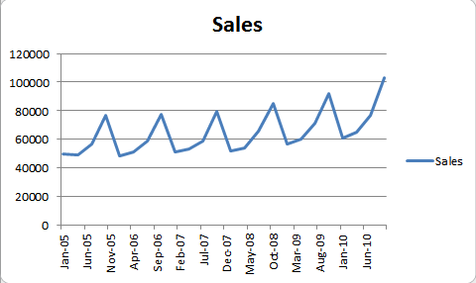
Definition
Time Series can be defined as a set of measurements of certain
variable made at regular time intervals.
Time acts as an independent variable for estimation
A time series defined by the values Y1, Y2.. of a variable Y
at times t1, t2, t3.. is given by :
Y = F (t)
Series of monthly sales data
Notes:
Trainer Notes:
Explain using a sample dataset in Excel or a dataframe in Jupyter notebook

Slide 6

Applications
Daily sales score of E-commerce
Weekly production of a shoe manufacturing company
Datasets
Yearly GDP of a developing country
Monthly tickets sold by an airline
Notice that all these datasets include time

Slide 7
Need
Understand seasonal patterns
Evaluate current progress
Detect unusual events
Forecasting

Slide 8
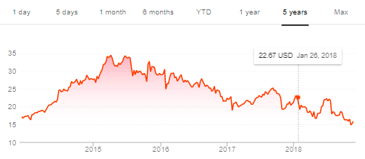
Time Series Pattern Types
Uptrend
Smartphone sales for a 3 year period
Downtrend
Stock Market price for a wall street company
A trend is a long-term increase or decrease in time series data
Trend
OPTION 01
Notes:
Trainer Notes:
1. Give more real-time examples

Slide 9
Time Series Pattern Types (Contd.)
When factors such as the time of the year or the day of the week affect the
dependent variable, repetitive patterns are observed in the time series
Seasonality is always of a fixed and known frequency
Seasonal
OPTION 01
Notes:
Trainer Notes:
1. Give few other real-time examples

Slide 10
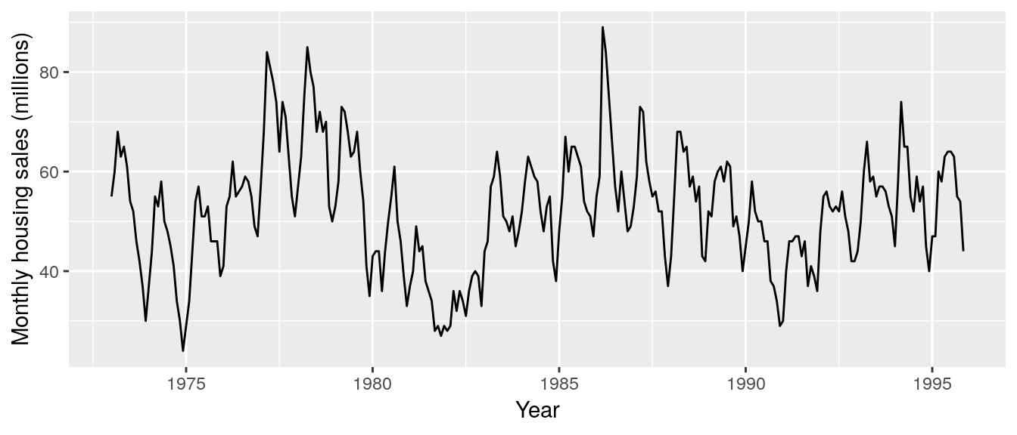
Time Series Pattern Types (Contd.)
Unlike seasonal patterns, cyclic patterns exhibit rise and fall that are not of fixed period
Duration is at least 2 years
Cyclic
OPTION 01
Notes:
Trainer Notes:
1. Give more real-time examples

Slide 11
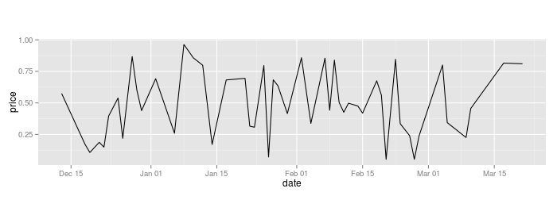
Time Series Pattern Types (Contd.)
Irregular patterns might occur due to random or unforeseen events
They are often of short duration and non-repeating
Irregular
OPTION 01
Notes:
Trainer Notes:
1. Give real-time examples

Slide 12
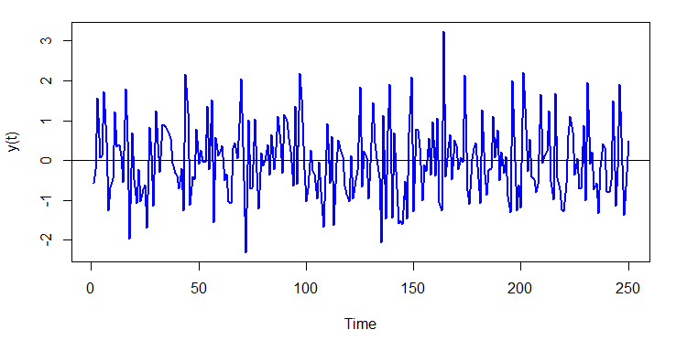

White Noise
A white noise series is one with a zero mean, a constant variance, and no correlation between its values at different times.
Since values are uncorrelated, the adjacent values do not help to forecast future values
Notes:
Trainer Notes:
1. Explain the need to identify white noise

Slide 13
White Noise (Contd.)
Data
Data
Forecasting
X
White Noise Feature
White Noise Feature
Y
Time Series Analysis
Time Series Analysis
Example: Stock prices of companies may vary daily and time series become uncorrelated

Slide 14
Time Series Modeling
Topic 2: Stationarity

Slide 15
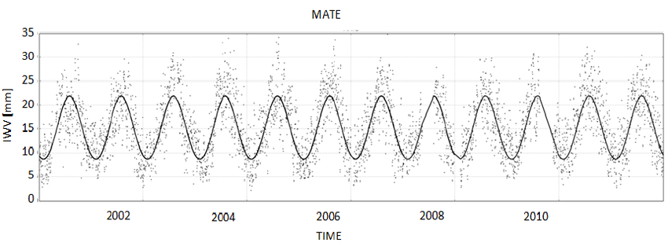
Stationarity
Criterion to classify a series as stationary
Time Invariant (constant)
Mean
Variance
Stationary series
Covariance
i
The time series should be stationary to build the model
Notes:
Trainer Notes: Explain the following
1. Stationary process and the parameters
2. Why does a time series have to be stationary?

Slide 16
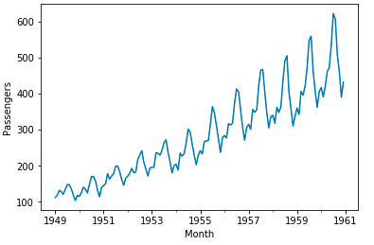
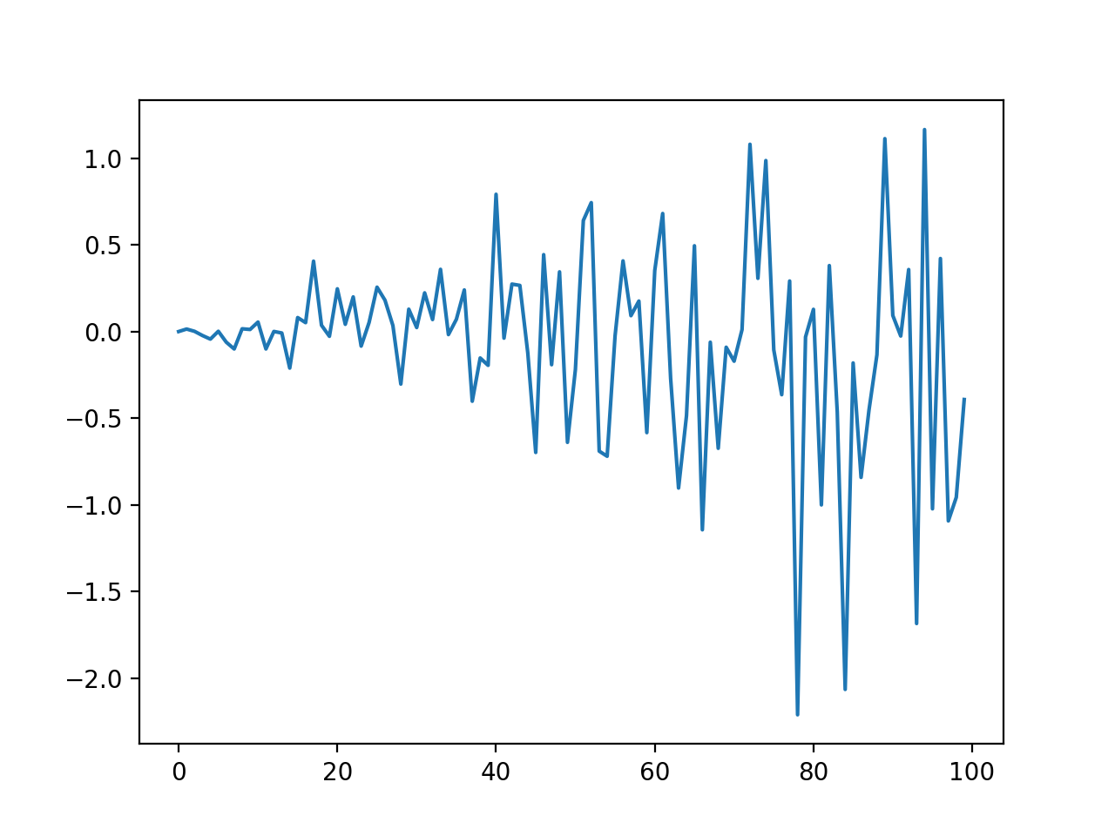

Non-Stationary Series
Increasing trend or non-constant mean
Non-constant variance
Co-variance is not constant with time
T

Slide 17
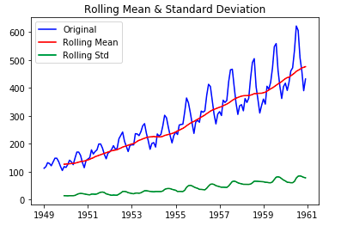
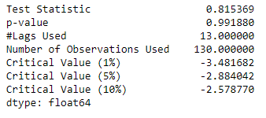
Stationarity Check
1
Rolling Statistics ( Visual )
2
Dickey Fuller test ( Statistical )
Plot the moving average or moving variance
to check if it varies with time.
Notice the mean and variance increase constantly
Null Hypothesis = TS is non-stationary
If ‘Test Statistic’ < ‘Critical Value’,
Reject the null hypothesis
Notes:
Trainer Notes: Explain the following
1. Rolling mean and Standard deviation
2. Test statistic and critical value

Slide 18
Removal of Non-Stationarity
Differencing
Decomposition
Getting a TS perfectly stationary is desirable but not practical, so it is made as close as possible using these statistical techniques

Slide 19
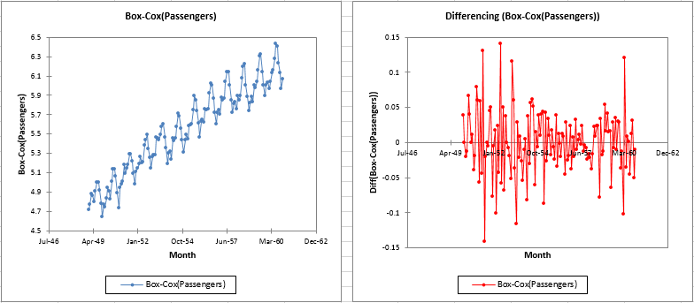

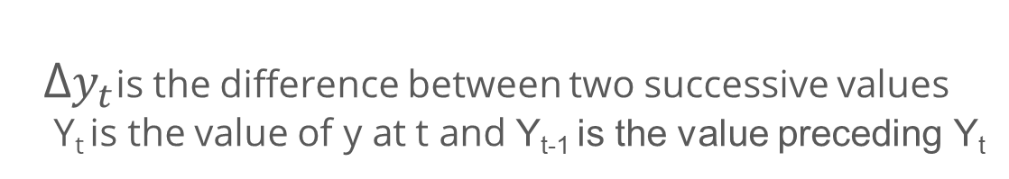
Differencing
Differencing is performed by subtracting the previous observation from the current observation.
∆$y_{t}$ = $y_{t}$ - $y_{t−1}$
∆$y_{t}$is the difference between two successive values
Y_{t} is the value of y at t and Y_{t-1} is the value preceding Y_{t}
Non-stationary series
On differencing the series on left
Notes:
Trainer Notes:
1. Explain the purpose of differencing
2. Demo differencing using Jupyter notebook

Slide 20
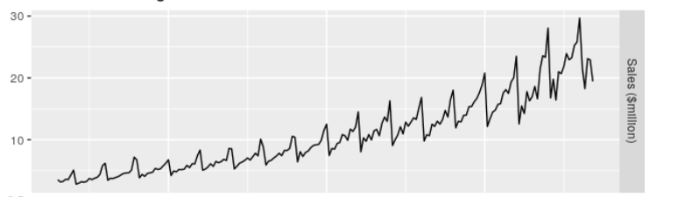
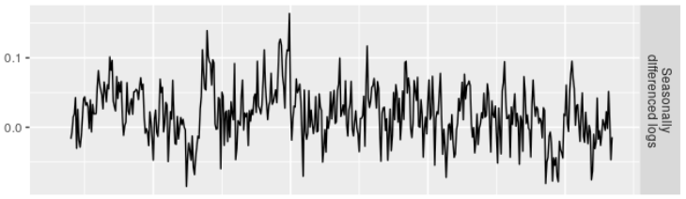

Decomposition
Detrending or de-seasonalizing eliminates the trend and seasonality respectively.
Decomposition is performed on the original series by regressing the series on time and taking the residuals from the regression.
$y_{t}$ = $μ$ + $β$t + $ε_{t}$
Seasonality with increasing trend
Seasonally decomposed series
i
You can also use techniques like transformation which penalize higher values more than lower values. Example: square root, cube root, log.
Notes:
Trainer Notes:
1. Explain the purpose of decomposition
2. Demo decomposition using Jupyter notebook

Slide 21
Assisted Practice
Stationarity
Duration: 15 mins.
Problem Statement: The Air Passenger dataset provides monthly total of US airline passengers, from 1949 to 1960.
This dataset is of a time series class.
Objective:
Check for the stationarity of your data using Rolling Statistics and Dickey fuller test
If stationarity is present, remove it using differencing in Python
Access: Click on the Labs tab on the left side panel of the LMS. Copy or note the username and password that are generated. Click on the Launch Lab button. On the page that appears, enter the username and password in the respective fields, and click Login.
Notes:
Trainer Notes:
Perform the above demo in python downloading the AirPassengers.csv dataset from the LMS.
Ask the learners to perform the same on their system simultaneously.

Slide 22
Unassisted Practice
Stationarity
Duration: 20 mins.
Problem Statement: The Beer production dataset provides a time series data for monthly beer production in Australia, for the period Jan 1956 – Aug 1995.
Objective:
Check for the stationarity of your data using Rolling Statistics and Dickey fuller test
if stationarity is present, remove it using differencing in Python
Access: Click on the Labs tab on the left side panel of the LMS. Copy or note the username and password that are generated. Click on the Launch Lab button. On the page that appears, enter the username and password in the respective fields, and click Login.
Notes:
Trainer Notes:
1. Ask the learners to perform the above demo by downloading the beer production dataset (in class) and help them, if needed.

Slide 23
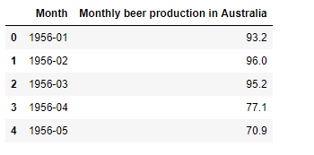
Step 1: Data Import
Code
import numpy as np
import pandas as pd
import matplotlib.pyplot as plt
from matplotlib.pyplot import rcParams
from datetime import datetime
%matplotlib inline
df = pd.read_csv('monthly-beer-production-in-austr.csv')
df.head()

Slide 24
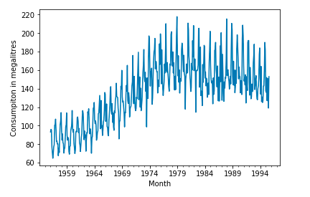
Step 2: Parse and Plot
Code
dateparse = lambda dates: pd.datetime.strptime(dates, '%Y-%m')
data = pd.read_csv('monthly-beer-production-in-austr.csv', parse_dates=['Month'], index_col='Month', date_parser=dateparse)
ts = data['Monthly beer production in Australia']
ts.plot()
plt.ylabel("Consumption in megalitres")

Slide 25
Step 3: Stationarity Check
from statsmodels.tsa.stattools import adfuller
def test_stationarity(timeseries):
#Determing rolling statistics
rolmean = timeseries.rolling(window=52,center=False).mean()
rolstd = timeseries.rolling(window=52,center=False).std()
#Plot rolling statistics:
orig = plt.plot(timeseries, color='blue',label='Original')
mean = plt.plot(rolmean, color='red', label='Rolling Mean')
std = plt.plot(rolstd, color='black', label = 'Rolling Std')
plt.legend(loc='best')
plt.title('Rolling Mean & Standard Deviation')
plt.show(block=False)
#Perform Dickey-Fuller test:
print ('Results of Dickey-Fuller Test:')
dftest = adfuller(timeseries, autolag='AIC')
dfoutput = pd.Series(dftest[0:4], index=['Test Statistic','p-value','#Lags
Used','Number of Observations Used'])
for key,value in dftest[4].items():
dfoutput['Critical Value (%s)'%key] = value
print (dfoutput)
test_stationarity(data['Monthly beer production in Australia'])

Slide 26
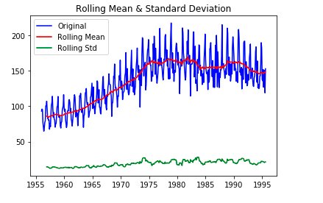
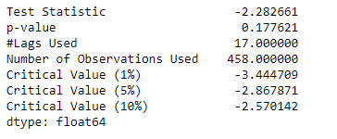
Output
The test statistic is more than critical value and the moving average is not constant over time.
So, the null hypothesis of the Dickey-Fuller test cannot be rejected.
This shows that the time series is not stationary.

Slide 27
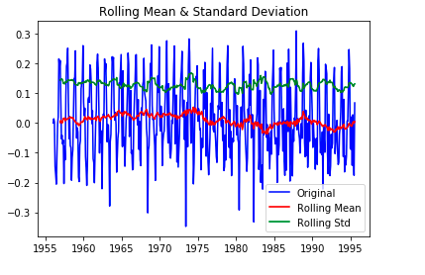
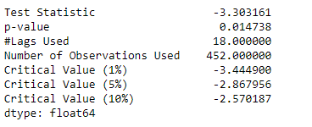
Step 4: Stationarize
ts_log_mv_diff = pd.rolling_mean(data[‘Monthly beer production in Australia].apply(lambda x: math.log(x)),2).diff(1)
ts_log_mv_diff.dropna(inplace=True)
ts_log_mv_diff.plot()
Test statistic < 5 % of critical value. Reject null hypothesis

Slide 28
Time Series Modeling
Topic 3: Various Time Series Models

Slide 29
Time Series Models
Autoregressive and Moving Average, or (ARMA model)
Models
Auto Regressive, or
(AR Model)
Autoregressive Integrated Moving Average, or
(ARIMA model)
Moving Average, or
(MA model)
Notes:
Trainer Notes:
1. Give a overview of the models

Slide 30
Auto Regressive (AR) Model
In an AR model, you predict future values based on a weighted sum of past values.
Equation for the auto regressive model :
Day | Price
1 | 21 | y_{t-p}
2 | 22 | .
3 | 23 | .
4 | 24 | .
5 | 23 | .
6 | 26 | .
7 | 27 | .
8 | 27 | .
9 | 29 | y_{t-3}
10 | 30 | y_{t-2}
11 | 32 | y_{t-1}
12 | ? | y_{t}
Y_{t} = c + ϕ₁Y_{t−1} + ϕ₂y_{t−2} + ⋯ + ϕ_{p}Y_{t−p} + e_{t}
Y_{t} is the function of different past values of the same variable
e_{t} is the error term
c is a constant
ϕ₁ to ϕ_{p} are the parameters
AR(1) is a model whose current value is based on the preceding value
AR(2) is based on the preceding two values
Notes:
Trainer Notes: Explain the following
1. Need for selection of model order

Slide 31
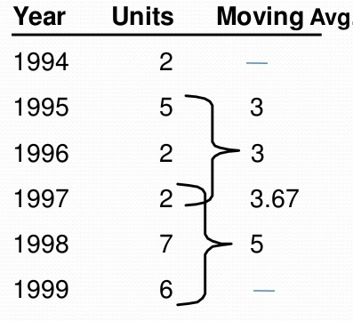
Moving Average (MA) Model
MA model is used to forecast time series if Y_{t} depends only on the random error terms.
Equation for the MA model :
Y_{t} = µ + ϕ₁ E_{t−1} + ϕ₂ E_{t−2} + ⋯ + ϕ_{p} E _{t−p}
Y_{t} is the function of different past error terms
µ is the mean of the series
E_{t} is the error term
ϕ₁ to ϕ_{p} are the parameters
The error terms here are assumed to be white noise processes with mean zero and constant variance.
Notes:
Trainer Notes: Explain the following
1. When MA is used
2. Problem with MA and the need for Trailing moving average

Slide 32


ARMA Model
ARMA model is used to forecast time series using both the past values and the error terms.
Equation for the ARMA model :
Y_{t} = c + ϕ₁Y_{t−1} + ϕ₂y_{t−2} + ⋯ + ϕ_{p}Y_{t−p} + e + µ + E_{t} + ϕ₁E_{t−1} + ϕ₂E_{t−2} +---------+ ϕ_{p} E_{t−p}
Autoregressive part
Moving Average part
ARMA
It is referred as ARMA ( p, q ), where p is autoregressive terms and q is moving average terms
Notes:
Trainer Notes:
1. Explain when to use ARMA

Slide 33
ARIMA Model
ARIMA model predicts a value in a response time series as a linear combination of its own past values,
past errors, also current and past values of other time series.
ARIMA ( p, d, q )
p is the order of the autoregressive part
d is the order of the differencing
q is the order of the moving-average process
If no differencing is done (d = 0), the models are usually referred to as ARMA(p, q) models
Notes:
Trainer Notes: Explain the following
1. When to use ARIMA
2. p, d, q values significance and how to choose the values

Slide 34
ACF and PACF
Autocorrelation refers to the way the observations in a time series are related to each other.
Autocorrelation Function (ACF)
ACF is the coefficient of correlation between the value of a point at a current time and its value at lag p,
that is, correlation between Y(t) and Y(t-p)
ACF will identify the order of MA process
Partial Autocorrelation Function (PACF)
PACF is similar to ACF, but the intermediate lags between t and t-p are removed, that is, correlation between Y(t) and Y(t-p) with p-1 lags excluded.
PACF will identify the order of AR process
ACF and PACF are used to determine the value of p and q
Notes:
Trainer Notes: Explain the following
1. ACF and PACF in details

Slide 35
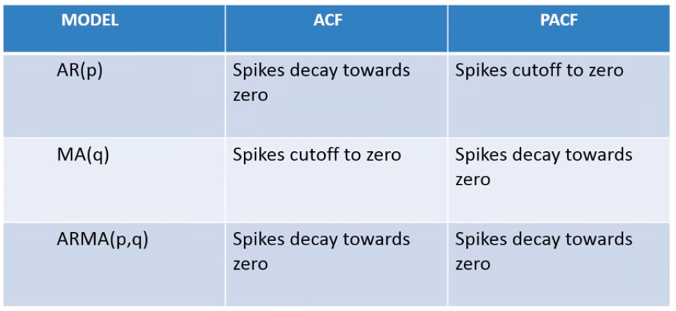
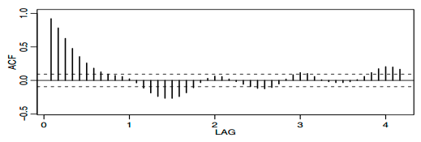
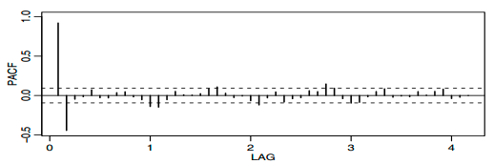
Characteristics of ACF and PACF
ACF “decays" to zero
PACF "cuts off“ to zero after the 2nd lag
Notes:
Trainer notes:
1. Explain how to interpret these plots and identify the p, q values

Slide 36
Steps in Time Series Forecasting
Step 01 Visualize the time series – check for trend, seasonality, or random patterns
Step 02 Stationarize the series using decomposition or differencing techniques
Step 03 Plot ACF / PACF and find ( p, d, q ) parameters
Step 04 Build ARIMA model
Step 05 Make predictions using final ARIMA model

Slide 37
Assisted Practice
Modeling
Duration: 15 mins.
Problem Statement: The Air Passenger dataset provides monthly total of US airline passengers, from 1949 to 1960. This dataset is of a time series class
Objective:
Perform ARIMA modeling in Python after obtaining ACF and PACF plots
Access: Click on the Labs tab on the left side panel of the LMS. Copy or note the username and password that are generated. Click on the Launch Lab button. On the page that appears, enter the username and password in the respective fields, and click Login.
Notes:
Trainer Notes:
Perform the above demo in python downloading the AirPassengers.csv dataset from the LMS.
Ask the learners to perform the same on their system simultaneously.

Slide 38
Unassisted Practice
Modeling
Duration: 15 mins.
Problem Statement: : The Beer production dataset provides a time series data for monthly beer production in Australia, for the period Jan 1956 – Aug 1995
Objective:
Perform ARIMA modeling in Python after obtaining ACF and PACF plots
Access: Click on the Labs tab on the left side panel of the LMS. Copy or note the username and password that are generated. Click on the Launch Lab button. On the page that appears, enter the username and password in the respective fields, and click Login.
Notes:
Trainer Notes:
1. Ask the learners to perform the above demo by downloading the beer production dataset (in class) and help them, if needed.

Slide 39
ACF and PACF
Code
plt.plot(np.arange(0,11), acf(ts_log_mv_diff, nlags = 10))
plt.axhline(y=0,linestyle='--',color='gray')
plt.axhline(y=-7.96/np.sqrt(len(ts_log_mv_diff)),linestyle='--',color='gray')
plt.axhline(y=7.96/np.sqrt(len(ts_log_mv_diff)),linestyle='--',color='gray')
plt.title('Autocorrelation Function')
plt.show()
plt.plot(np.arange(0,11), pacf(ts_log_mv_diff, nlags = 10))
plt.axhline(y=0,linestyle='--',color='gray')
plt.axhline(y=-7.96/np.sqrt(len(ts_log_mv_diff)),linestyle='--',color='gray')
plt.axhline(y=7.96/np.sqrt(len(ts_log_mv_diff)),linestyle='--',color='gray')
plt.title('Partial Autocorrelation Function')
plt.show()

Slide 40
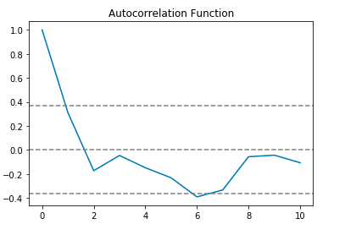
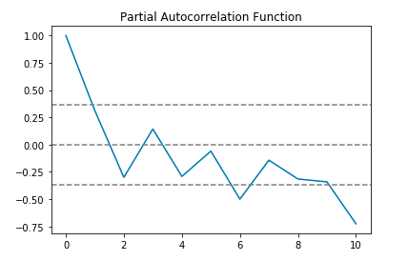
Output
ACF curve crosses the upper confidence value when the lag value is between 0 and 1 Thus, optimal value of q in the ARIMA model must be 0 or 1
The PACF curve drops to 0 between lag values 1 and 2
Thus, optimal value of p in the ARIMA model is 1 or 2

Slide 41
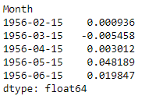
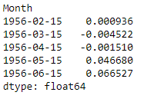
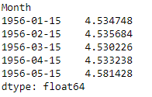
ARIMA
Code
model = ARIMA(ts_log, order=(1, 1, 0)) results_ARIMA = model.fit(disp=-1) plt.plot(ts_log_mv_diff) plt.plot(results_ARIMA.fittedvalues, color='red') plt.title('RSS: %.4f’% (((results_ARIMA.fittedvalues[1:] - ts_log_mv_diff)**2).mean()))
predictions_ARIMA_diff = pd.Series(results_ARIMA.fittedvalues, copy=True) predictions_ARIMA_diff.head()
predictions_ARIMA_diff_cumsum = predictions_ARIMA_diff.cumsum() predictions_ARIMA_diff_cumsum.head()
predictions_ARIMA_log = pd.Series(ts_log.ix[0], index=ts_log.index) predictions_ARIMA_log = predictions_ARIMA_log.add(predictions_ARIMA_diff_cumsum,fill_value=0) predictions_ARIMA_log.head()

Slide 42
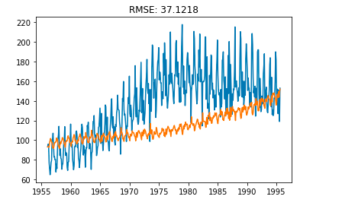
ARIMA
Code
predictions_ARIMA = np.exp(predictions_ARIMA_log)
plt.plot(ts)
plt.plot(predictions_ARIMA)
plt.title('RMSE: %.4f'% np.sqrt(((predictions_ARIMA-ts)**2)/(ts)).mean())
Notes:
Trainer notes:
Explain how accuracy of the model can be improved.

Slide 43
Now, you are able to:
Understand time series analysis
Build time series models using ARIMA

Slide 44

© Simplilearn. All rights reserved.

Slide 45
Which of the following cannot be a part of time series data?
1
Trend
Seasonality
Noise
None of the above
© Simplilearn. All rights reserved.

Slide 46
Which of the following cannot be a part of time series data?
1
Trend
Seasonality
Noise
None of the above
d. None of the above
Options a, b, c are time series components.

Slide 47
Which of the following techniques can be used to make a series stationary?
2
Transformation
Differencing
Decomposition
All of the above
© Simplilearn. All rights reserved.

Slide 48
Which of the following techniques can be used to make a series stationary?
2
Transformation
Differencing
Decomposition
All of the above
d. All of the above
All of these techniques are used to stationarize a time series

Slide 49
Lesson-End Project
IMF Commodity Price Forecast
Duration: 20 mins.
Problem Statement: You are provided with a dataset which consists of Zinc prices for the period Jan 1980 – Feb 2016
Objective:
Visualize the time series
Check for the stationarity of your data using Rolling Statistics and Dickey fuller test and if present, remove it using stationarity removal techniques
Plot ACF and PACF plots. Find p, d, q values
Perform ARIMA modeling
Forecast the prices using the new model
Access: Click on the Labs tab on the left side panel of the LMS. Copy or note the username and password that are generated. Click on the Launch Lab button. On the page that appears, enter the username and password in the respective fields, and click Login.
Notes:
Trainer Notes: Describe the project to the learners and instruct them to perform it after the lesson.

Slide 50
© Simplilearn. All rights reserved.

